Slide 1
HARIVIGNESH
Final Project
1

Slide 2
Next-Generation Crop
Yield Prediction for Precision Agriculture And Food Security
3/21/2024 Annual Review
2

Slide 3


AGENDA
Precision agriculture is a rapidly evolving field that leverages advanced technologies to optimize crop production and resource utilization.
This presentation explores a next- generation solution for accurate crop
yield prediction, a critical component of precision farming.
3/21/2024 Annual Review
3

Slide 4

PROBLEM STATEMENT
1
Inaccurate Yield
Forecasting
2 inefficient
Resource Allocation
3
Reduced Profitability
Inaccurate predictions impa ct farmers' ability to make informed decisio ns, leading
to decreased
yields
and reduced
profitability.
Current
yield prediction
methods often rely on historical data and
generalized models
, leading
to inaccurate forecasts that fail to account for site-
Imprecise yield estimates result in suboptimal resourc e allocation,
such as over or under-application of fertilizers, water, and other inputs.
4

Slide 5

PROJECT OVERVIEW
Objective Approach
Expected Outcomes
Develop a next- generation crop yield
prediction system that leverages advanced
data analytics and machine learning to provide accurate, site-
Integrate real-time sensor data, satellite imagery, and historical records to
create a comprehensive model that adapts to local conditions
and evolving
environmental factors.
Improved yield forecasting accuracy, optimized resource allocation, and increased profitability for farmers and agricultural enterprises.
specific forecasts.

Slide 6
WHO ARE THE END USERS?
FARMERS
The primary end users of the crop yield prediction system are farmers who
require accurate forecasts to make informed decisions about resource
allocation, planting, and harvesting.
Policymakers
Government agencies and policymakers can leverage the system's data to
inform agricultural policies, disaster response planning, and food security initiatives.
Agricultural Enterprises
Agricultural companies, cooperatives,
and agribusinesses can also benefit from the
system's insights to optimize supply chain logistics, inventory management, and market planning.
Researchers
The system's data and insights can also be valuable for academic and scientific researchers studying crop production, climate change, and sustainable agriculture.

Slide 7
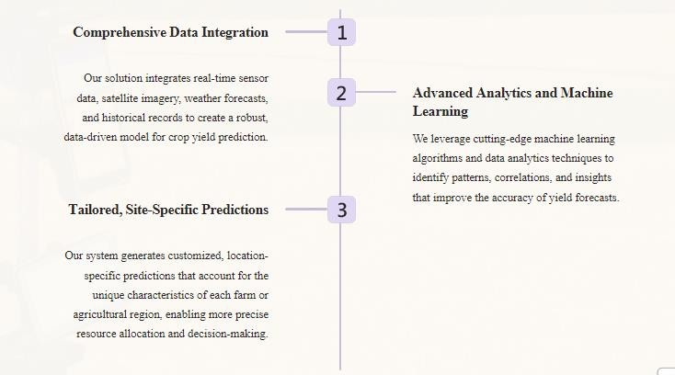

YOUR SOLUTION AND ITS VALUE PROPOSITION

Slide 8





THE WOW IN YOUR SOLUTION
Unparalleled Accurac
y
Our
advanced predictiv e
models consistently outperform traditio nal
yield forecasting methods, delivering
accuracy improvem ents of up to 30%.
Real-Time Insights Scalable
User-
Our system provides near real-time updates on crop conditions
and yield
projections, enabl ing farmers
to respond quickly
to changing
circumstances.
and Adaptabl
eThe platform is designed to be scalable
and adaptable, allowing it to be deployed across
Friendly Interface
Our intuitive, web- based
dashboard provides easy access to all the data and
insights, empowering
users to make
diverse agricultural_{informed decisions}
regions and crop types
with confidence.

Slide 9




MODELLING
Data Collection
Gather real-time sensor data, satellite imagery, weather forecasts, and historical records to create a comprehensive dataset.
Feature Engineering
Identify and extract relevant features from the data that can be used to train the predictive models.
Model Training
Apply advanced machine learning algorithms to the dataset, continuously refining the models to improve accuracy.
Deployment
Integrate the trained models into a user-friendly platform, providing real-time yield predictions and insights.

Slide 10
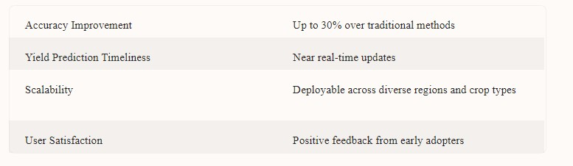
RESULTS
Crop yield prediction in precision agriculture offers data-driven insights for optimized farming practices, enhancing productivity and resource efficiency.

